Slide 1

SAP BTP ABAP on Cloud / RAP Training
DAY-13
Anubhav Oberoy
www.AnubhavTrainings.com
Follow excellence with sheer passion

Slide 2


DISCLAIMER
The training content and delivery of this presentation is confidential, and cannot be recorded, or copied and distributed to any third party, without the written consent of Anubhav Trainings

Slide 3

01
Fiori Elements
02
Git and Git HUB
03
Build Workzone
04
Integration
Notes:
https://pixabay.com/photos/san-francisco-transamerica-pyramid-1633203/

Slide 4
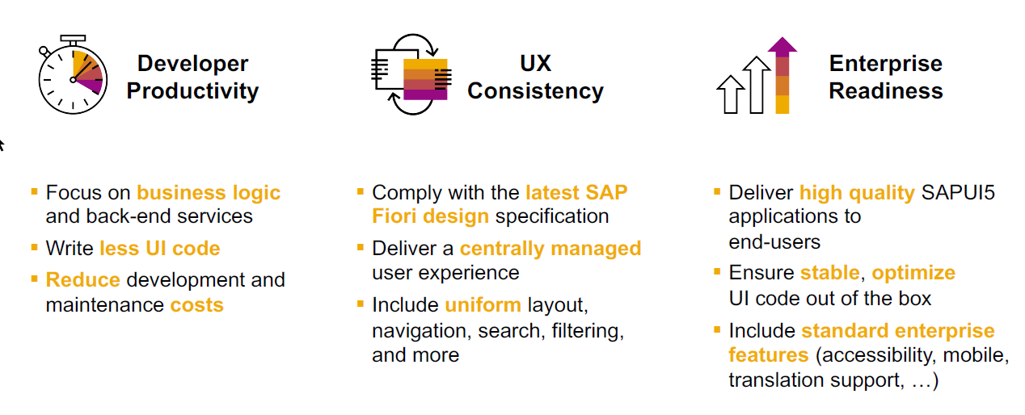
SAP Fiori elements boosts SAP Fiori development efficiency

Slide 5
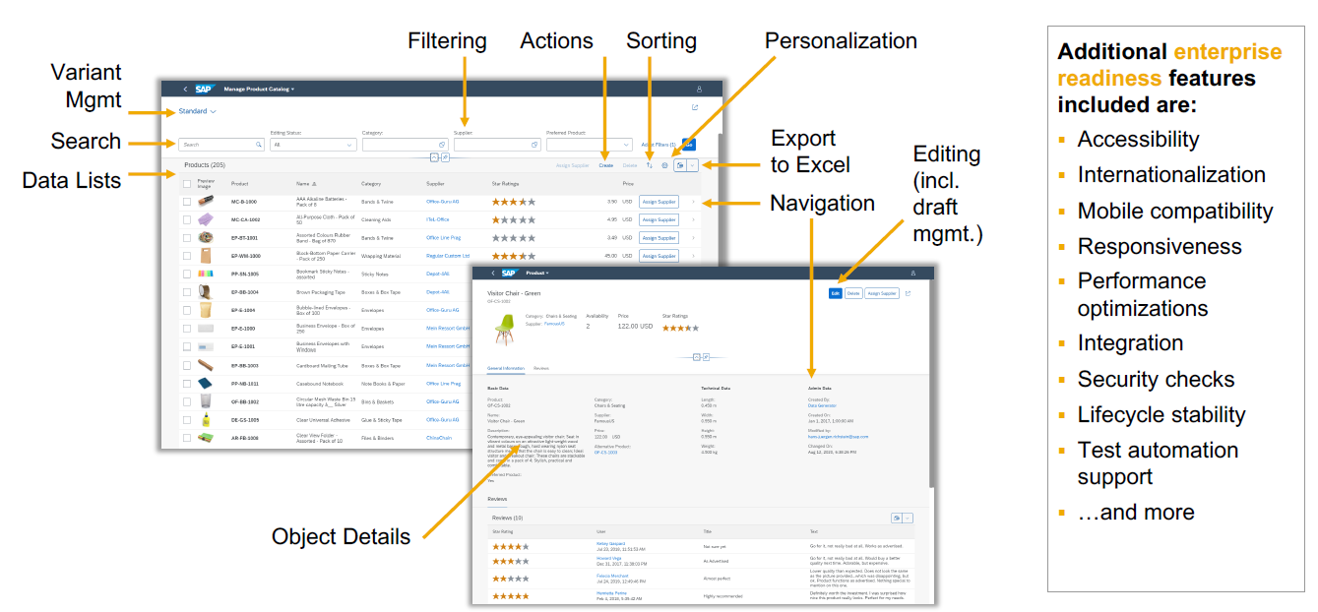
SAP Fiori elements provides enterprise-ready apps out of the box

Slide 6
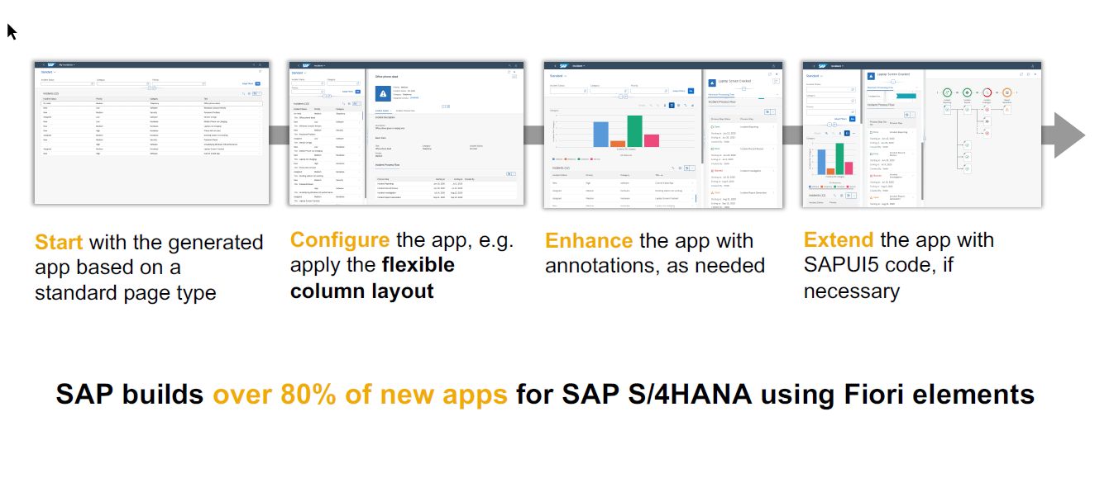
SAP Fiori elements application architecture provides flexibility

Slide 7

SAP Fiori elements prioritizes efficiency over flexibility

Slide 8
Structure of the Fiori App
Currently you are testing the Fiori App by using the standard preview option in eclipse tool. Will our end user have the ability and skill to open eclipse tool, go to package and search BIMP and then open preview and that too in production system.
All the Fiori apps which we create in BTP will be called MTA – Multi target application, they are deployed with mta.yml file. Which will contain the configuration for the Fiori App.
In SAP BTP, there is a storage space called html-5-repository where the BTP will store our Fiori apps.
When we deploy our app, there is html5-deployer which will take our app from BAS tool and deployes it to the HTML5 Repository (Design time)
When we run the app, there is a service called html5-rt (runtime) service which will load our app from the repository in the build workzone.
Apart from that the application will contain a connectivity service to communicate with our abap on cloud system.
And a destination service which will read the destination (RFC) of AOC system to access data in Fiori.
www.anubhavtrainings.com

Slide 9
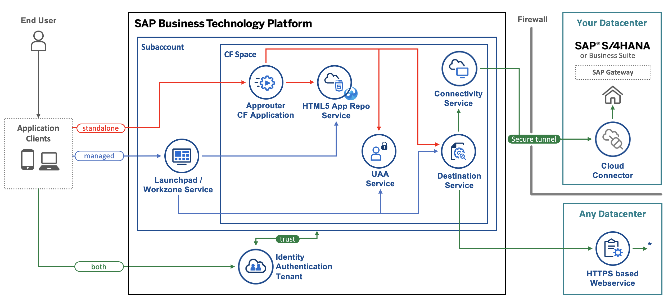
Architecture
www.anubhavtrainings.com
Notes:
https://www.google.com/url?sa=i&url=https%3A%2F%2Fcommunity.sap.com%2Ft5%2Ftechnology-blogs-by-sap%2Fbuild-and-deploy-ui5-freestyle-applications-to-sap-btp-cloud-foundry%2Fba-p%2F13558501&psig=AOvVaw3K_6niI7dmyPfs2VgcYMQf&ust=1726066695091000&source=images&cd=vfe&opi=89978449&ved=0CBcQjhxqFwoTCOicgdPRuIgDFQAAAAAdAAAAABAg

Slide 10
Tools and Services to Deliver the App
Business Application Studio – It is a multi cloud development tool which allows developers to build, test, package, deploy, and manage end to end Fiori applications.
SAP build work zone (aka cFLP in BTP) – it helps us to configure a site called Fiori launchpad in the cloud. All the Fiori Apps which you build in BTP will be accessed via this build workzone from end user. End user will get single URL, which contains the tiles for all our apps deployed in BTP.
Continuous Integration Service – When a developer change the application, and push to central repository like git, the CI service will automatically build and deploy our app.
www.anubhavtrainings.com

Slide 11
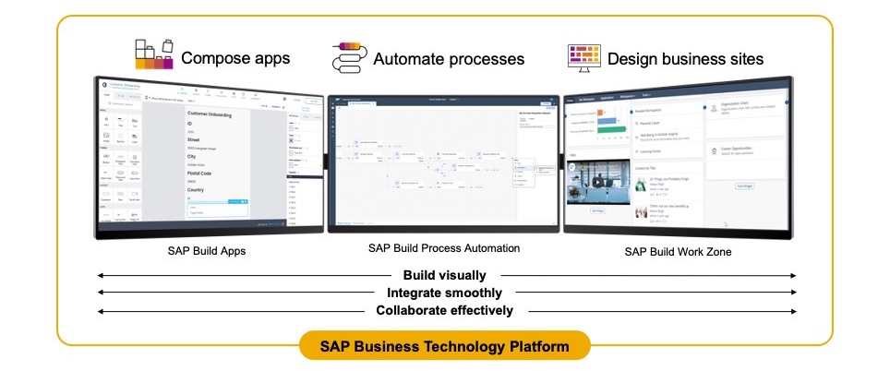
SAP Build – An introduction
www.anubhavtrainings.com

Slide 12
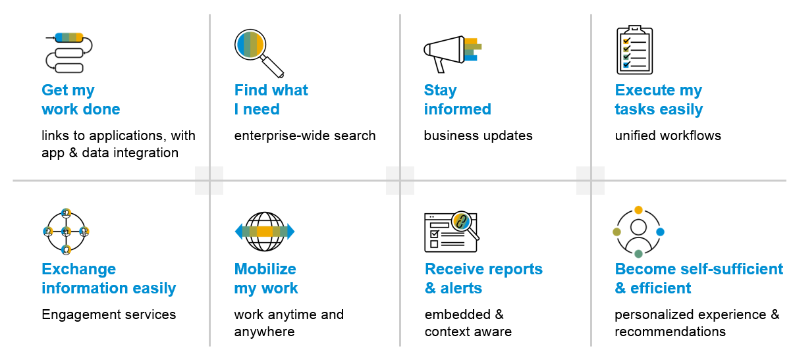
SAP Build Work zone – Key benefits
www.anubhavtrainings.com

Slide 13
Additional configuration before deployment
{
"xsappname": "comatstproctravelprocessorapp",
"tenant-mode": "dedicated",
"description": "Security profile of called application",
"scopes": [],
"role-templates": [],
"oauth2-configuration": {
"token-validity": 60000,
"refresh-token-validity": 2592000,
"redirect-uris": [
"https://*.cfapps.us10-001.hana.ondemand.com/login/callback"
]
}
}
www.anubhavtrainings.com

Slide 14
How did Anubhav build and deploy fiori
Create the Dev space in BAS tool
Open the bas tool and open folder to choose projects folder
We have to open terminal and login to btp a/c cf login -a https://api.cf.us10-001.hana.ondemand.com --sso
Press F1 and choose open application generator to generate Fiori app of template: List Report Template
Select the system as AOC and choose our service binding name for processor
Provide app details, deployment details (btp), launchpad details and create app
Right click on mta.yml and build MTA archieve
Choose F1, open application info and select deploy
Assign the roles of our Launchpad service to our user
Open SAP Build workzone and create a site with name mylaunchpad
Go to channel manager and refresh the apps which are stored in html5-repository
Go to content manager and choose content explorer and pull the app
Create a catalog and a group and add our app to them
Go to everyone role and assign the app to the role
Open the site to test our app
Repeat the same steps if there is a change in the app.
We need to create a git repository and push our app code (backup)
Register a web hook and use the same in CI CD service so that the application will deploy automatically to BTP cloud
www.anubhavtrainings.com

Slide 15
Git and ABAP on git
Git is a source code repository management system, git hub is a repository on internet. We interact with github using git software. If I want to take a backup of all our code which we created in AOC system, git is a great choice. This way we can also export import our code between cloud and on-premise system.
For cloud system, we use git plugin in eclipse which is provided by SAP. The installation was covered in 3rd session.
Steps:
We need to add the plugin for abap git in ADT - http://eclipse.abapgit.org/updatesite/
Create a github account and add a PAT token under developer setting
Create a repository in git hub
Click on Add to link a repository and paste url from step 3
www.anubhavtrainings.com

Slide 16
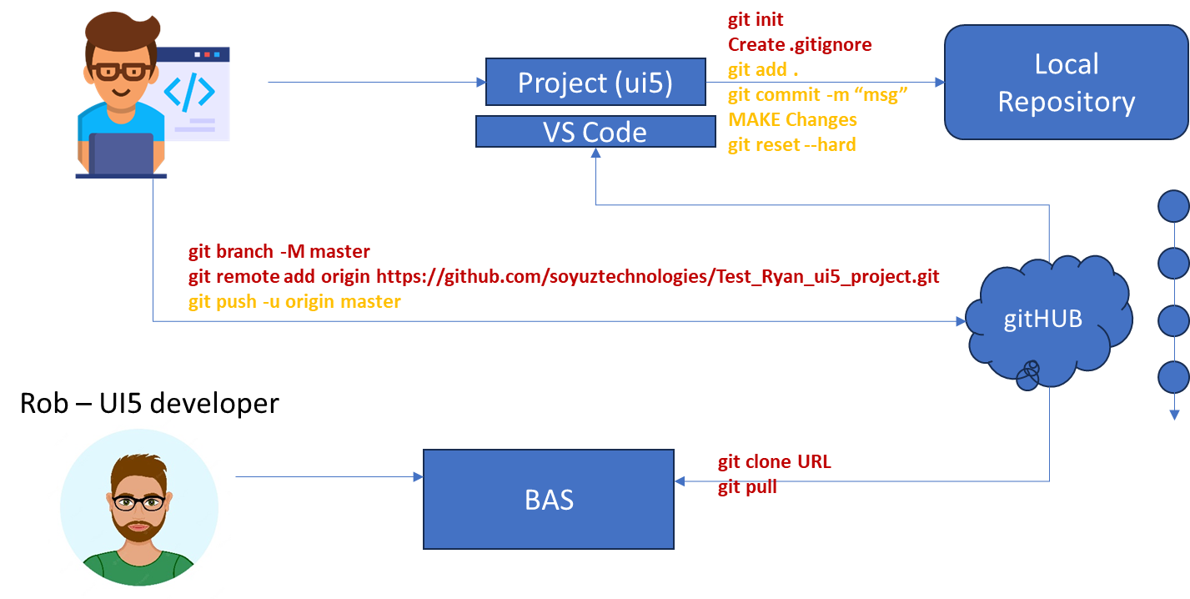
Git and Git HUB

Slide 17
Architecture
www.anubhavtrainings.com
Notes:
https://www.google.com/url?sa=i&url=https%3A%2F%2Fcommunity.sap.com%2Ft5%2Ftechnology-blogs-by-sap%2Fbuild-and-deploy-ui5-freestyle-applications-to-sap-btp-cloud-foundry%2Fba-p%2F13558501&psig=AOvVaw3K_6niI7dmyPfs2VgcYMQf&ust=1726066695091000&source=images&cd=vfe&opi=89978449&ved=0CBcQjhxqFwoTCOicgdPRuIgDFQAAAAAdAAAAABAg

Slide 18
Git and ABAP on git
Git is a source code repository management system, git hub is a repository on internet. We interact with github using git software. If I want to take a backup of all our code which we created in AOC system, git is a great choice. This way we can also export import our code between cloud and on-premise system.
For cloud system, we use git plugin in eclipse which is provided by SAP. The installation was covered in 3rd session.
Steps:
We need to add the plugin for abap git in ADT - http://eclipse.abapgit.org/updatesite/
Create a github account and add a PAT token under developer setting
Create a repository in git hub
Click on Add to link a repository and paste url from step 3
www.anubhavtrainings.com

Slide 19




Git and Git HUB

Slide 20
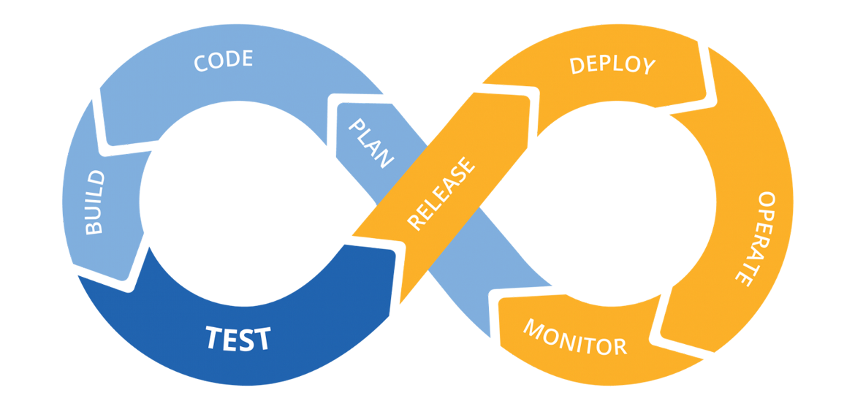
Hands on: Continuous Integration

Slide 21
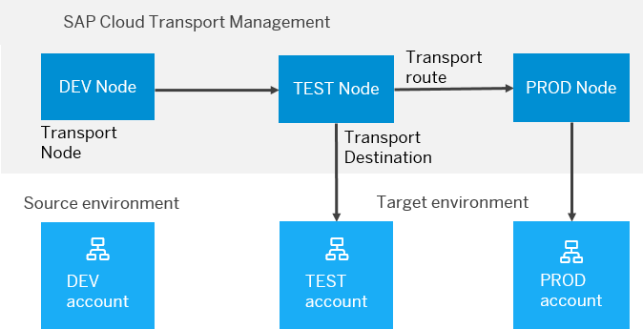
BTP Cloud Transport Management
SAP Cloud Transport Management service lets you manage software deliverables between accounts of different environments (such as Neo and Cloud Foundry), by transporting them across various runtimes. This includes application artifacts as well as their respective application-specific content.
SAP Cloud Transport Management service adds transparency to the audit trail of changes so that you get information about who performed which changes in your production environment, and when they did it. At the same time, the service enables a separation of concerns: For example, a developer of an application or of SAP Cloud content artifacts can trigger the transport of changes in a development subaccount, while the resulting import into the test, and production subaccount is handled by a central operations team.

Slide 22

Hands on SAP BTP Cloud Transport

Slide 23
www.anubhavtrainings.com
Thank You
End of Day 13
www.anubhavtrainings.com

Slide 24


We’re committed to empower you to be
#FutureReady
through powerful training solutions.
We build the workforce of the future.
250+
Corporate Clients
30,000+
Learners Trained
25000+
Learners Placed
FREE WEBINARS
Sign up for free webinars with industry experts every fortnight!
Enroll Now!
Contact us today!
https://anubhavtrainings.com

